Slide 1
Showwcase User
Engagement Analysis

Slide 2
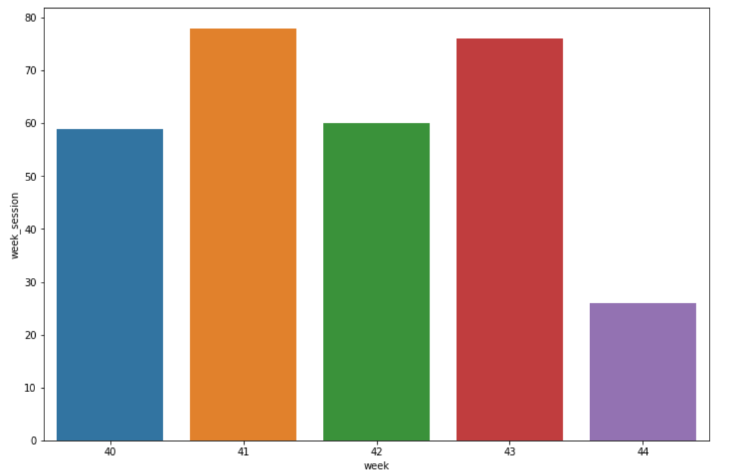
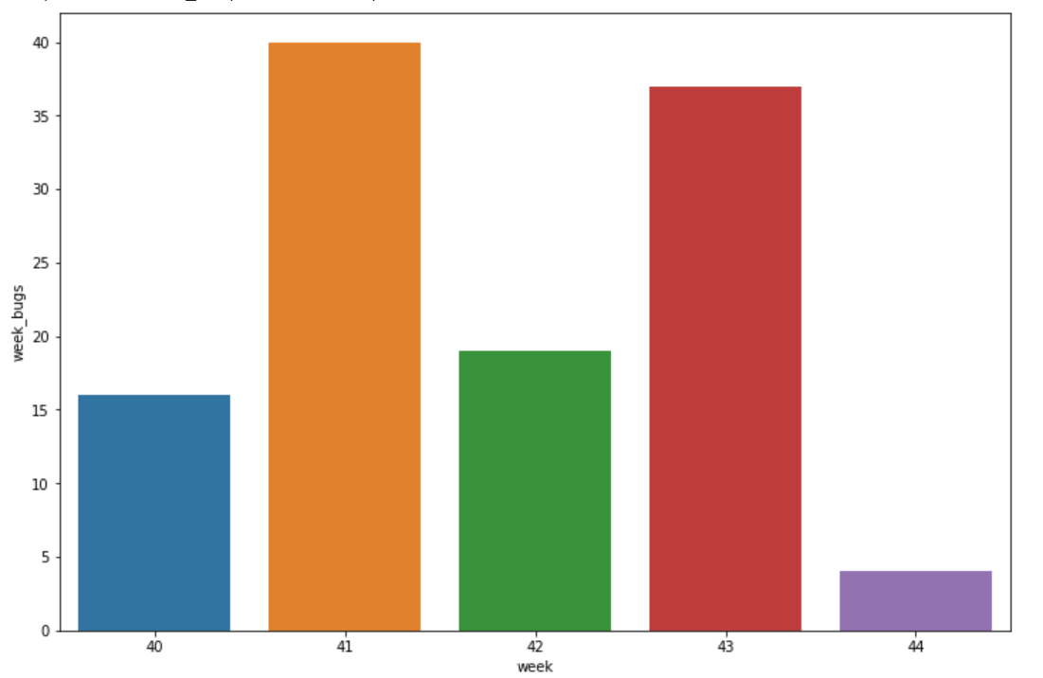
We can conclude that as the session increases people are more engaged with adding projects, giving likes, comments and hence there are possibility of bug occurring as seen from graph above

Slide 3
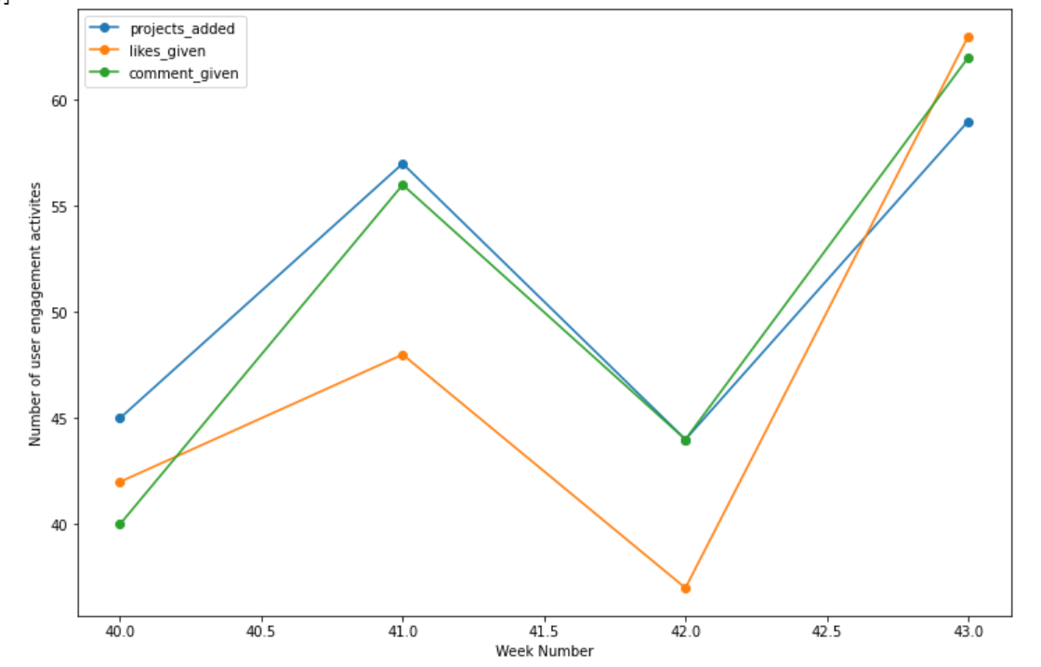
We can see that as the month proceeds towards the end, the engagement also increases, but you can see that in week 44 engagement is less because there were only 4 days in that particular week

Slide 4
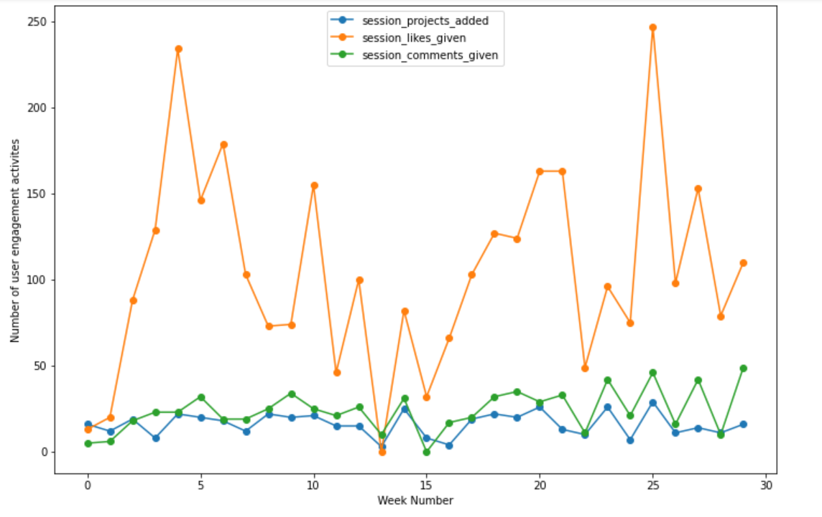
All user engagements have increased during the end of the month and were more during the start whereas decreased during the mid month.
The number of projects and comments added were moreover constant
The engagement through likes kept on changing
Engagement through projects and comments are less as compared to likes given

Slide 5
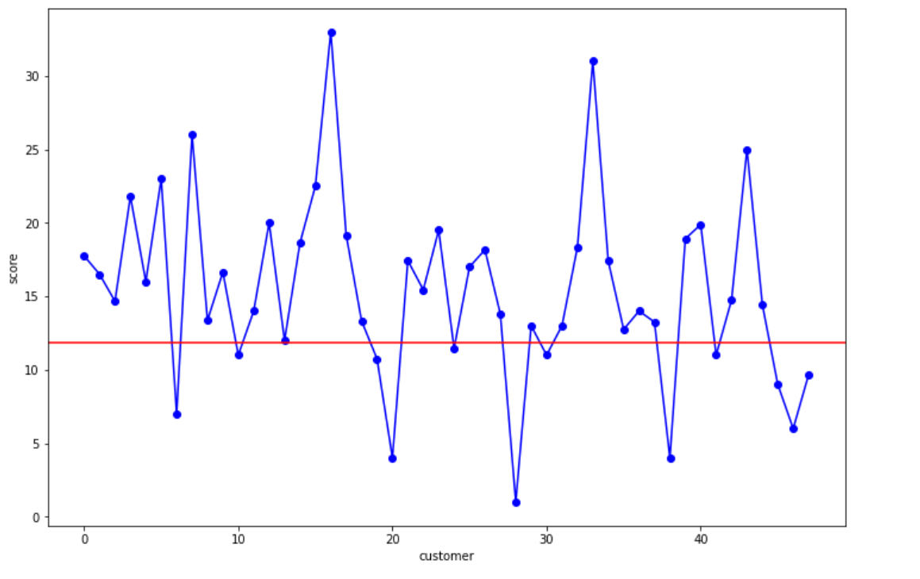
Created scores based on projects added, likes and comments

Slide 6
Each customers score can be seen above. I have considered the 25 percentile for minimum score. Customers with more than 25 percentile can be considered as those with more engagement as well
Recommendation : User engagement can be increased by decreasing the number of bugs and making the UI smooth for users.

Slide 7
End

